Slide 1
MIPS Pipeline
Data and Control Path
Notes:
Morgan Kaufmann Publishers
Chapter 4 — The Processor

Slide 2
MIPS Pipeline
To Increase the Speed of execution of program
  Faster circuit technology to implement the processor and the main memory
  Arrange the hardware so that more than one operation can be performed at the same time.
    the number of operations performed per second is increased
    the time needed to perform any one operation is not changed
Pipelining is a way of organizing concurrent activity in a computer
Notes:
Morgan Kaufmann Publishers
Chapter 4 — The Processor

Slide 3
MIPS Pipeline
Five stages, one step per stage
  IF: Instruction fetch from memory
  ID: Instruction decode & register read
  EX: Execute operation or calculate address
  MEM: Access memory operand
  WB: Write result back to register
Notes:
Morgan Kaufmann Publishers
Chapter 4 — The Processor

Slide 4
Performance Issues
Longest delay determines clock period
  Critical path: load instruction
  Instruction memory → register file → ALU → data memory → register file
Not feasible to vary period for different instructions
All instructions will follow all 5 stages in pipeline
Notes:
Morgan Kaufmann Publishers
Chapter 4 — The Processor

Slide 5
Pipeline Performance
Assume time for stages are
  100ps for register read or write
  200ps for other stages
Single-cycle datapath need worst-case clock cycle of 800 ps,
Pipelined datapath need worst-case clock cycle of 200 ps
Instr | Instr fetch | Register read | ALU op | Memory access | Register write | Total time
lw | 200ps | 100 ps | 200ps | 200ps | 100 ps | 800ps
sw | 200ps | 100 ps | 200ps | 200ps |  | 700ps
R-format | 200ps | 100 ps | 200ps |  | 100 ps | 600ps
beq | 200ps | 100 ps | 200ps |  |  | 500ps
Notes:
Morgan Kaufmann Publishers
Chapter 4 — The Processor

Slide 6
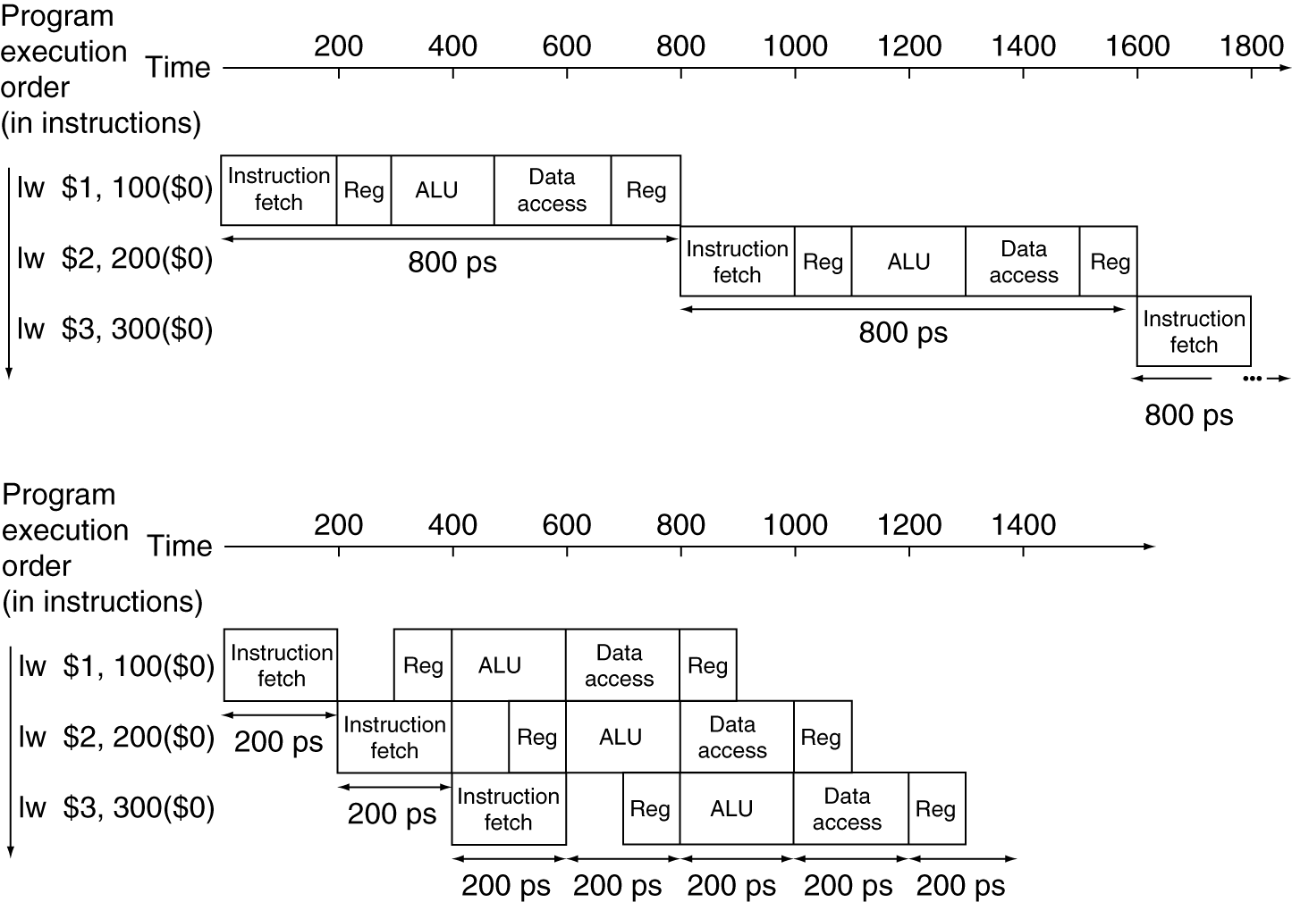
Pipeline Performance
The time between the first and fourth instructions is 3 × 200 ps or 600 ps for Pipeline.
Single-cycle (T_{c}= 800ps)
Pipelined (T_{c}= 200ps)
Notes:
Morgan Kaufmann Publishers
Chapter 4 — The Processor

Slide 7

Pipeline Speedup
Speedup from pipelining is approximately equal to the number of pipe stages;
a five-stage pipeline is nearly five times faster.
800/5 =160ps clock cycle
If all stages are balanced (all stage take the same time)
Pipelining offers a fourfold performance improvement (800/200=4)
If balanced, speedup is less: in our example 200ps
Notes:
Morgan Kaufmann Publishers
Chapter 4 — The Processor

Slide 8
Pipelining and ISA Design
MIPS ISA designed for pipelining
  All instructions are 32-bits
    fetch and decode each takes only one cycle
  Few and regular instruction formats
    Can decode and read registers in one step
    (read register are in same place (rs))
  Only Load/store use memory operand
    Can calculate address in 3rd stage, access memory in 4th stage
  Memory Operand Alignment
    4bytes – address multiples of four
    Memory access takes only one cycle
Notes:
Morgan Kaufmann Publishers
Chapter 4 — The Processor

Slide 9
Pipelining Issues
Hazards
  A new instruction enter the pipeline in every cycle
  Situations in pipelining when the next instruction cannot execute in the following clock cycle - called hazards
Types
    Structure hazards
      A required resource is busy
    Data hazard
      Need to wait for previous instruction to complete its data read/write
    Control hazard
      Deciding on control action depends on previous instruction
Notes:
Morgan Kaufmann Publishers
Chapter 4 — The Processor

Slide 10
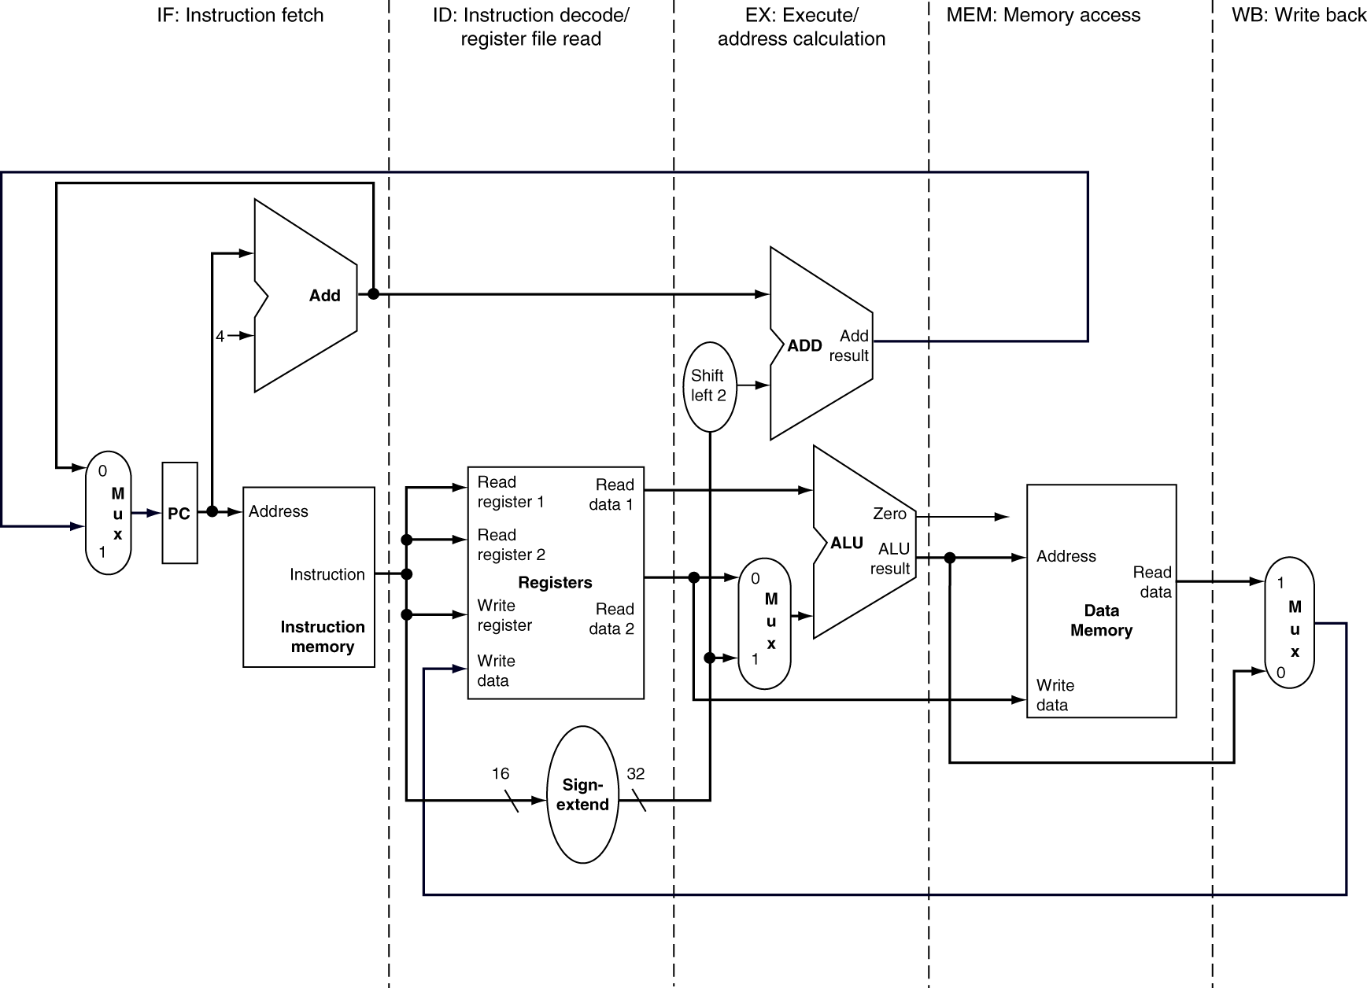
MIPS Pipelined Datapath
5 stages
  IF:
  ID
  EX:
  MEM:
  WB:
MEM
WB
Right-to-left flow leads to hazards (MEM – control hazard, WB – data hazard)
Notes:
Morgan Kaufmann Publishers
Chapter 4 — The Processor

Slide 11
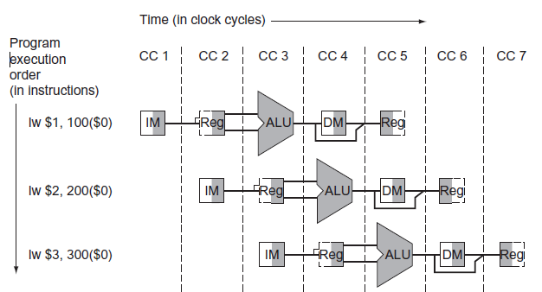
MIPS Pipelined Datapath
Read
Write
Three instructions need three datapaths
Add registers to hold data so that portions of a single datapath can be shared
Notes:
Morgan Kaufmann Publishers
Chapter 4 — The Processor

Slide 12
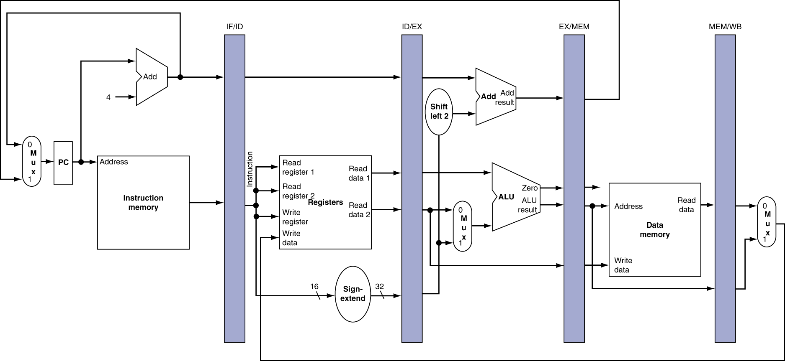
Pipeline registers
Need registers between stages
  To hold information produced in previous cycle
All instructions advance during each clock cycle from one pipeline register to the next.
No need of pipeline register at the end of the write-back stage as it updates register file, memory, or the PC
PC is part of the visible architectural state; its contents must be saved when an exception occurs, while the contents of the pipeline registers can be discarded.
Notes:
Morgan Kaufmann Publishers
Chapter 4 — The Processor

Slide 13
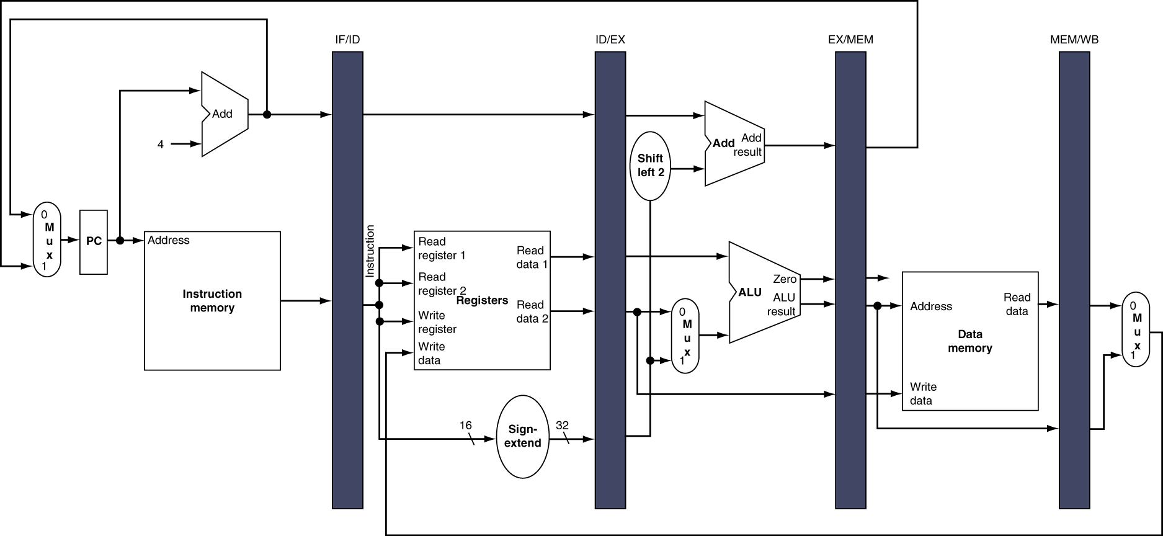
Notes:
Morgan Kaufmann Publishers
Chapter 4 — The Processor

Slide 14
Pipeline Operation
Cycle-by-cycle flow of instructions through the pipelined datapath
  “Single-clock-cycle” pipeline diagram
    Shows pipeline usage in a single cycle
    Highlight resources used
  c.f. “multi-clock-cycle” diagram
    Graph of operation over time
Notes:
Morgan Kaufmann Publishers
Chapter 4 — The Processor

Slide 15
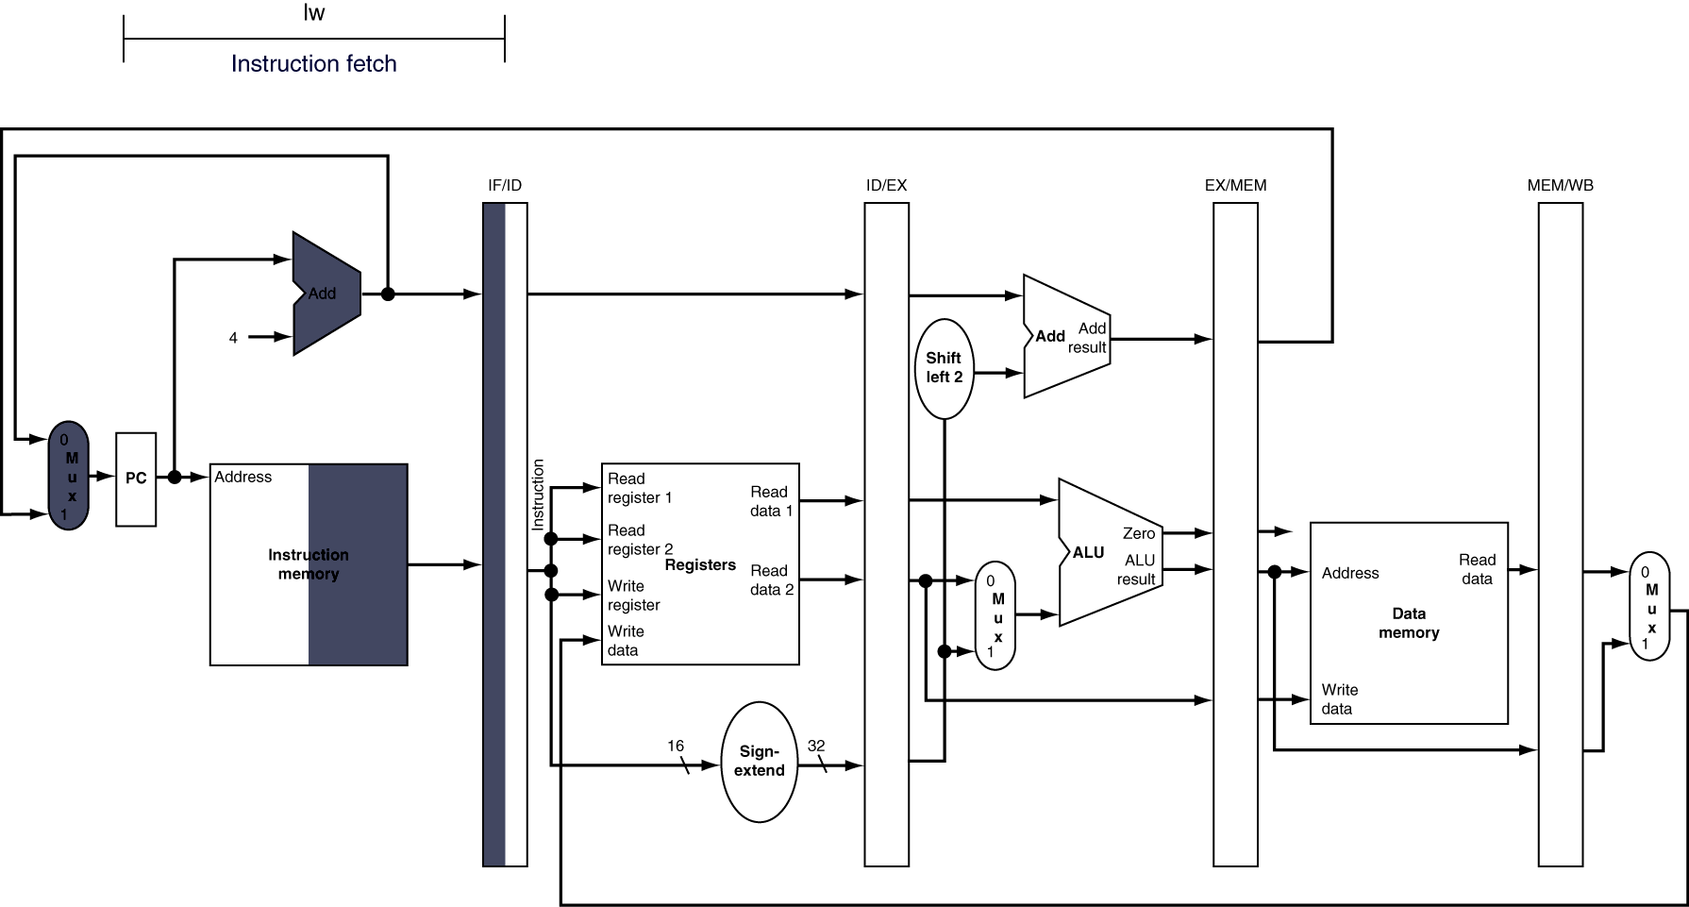
IF for Load, Store, …
Notes:
Morgan Kaufmann Publishers
Chapter 4 — The Processor

Slide 16
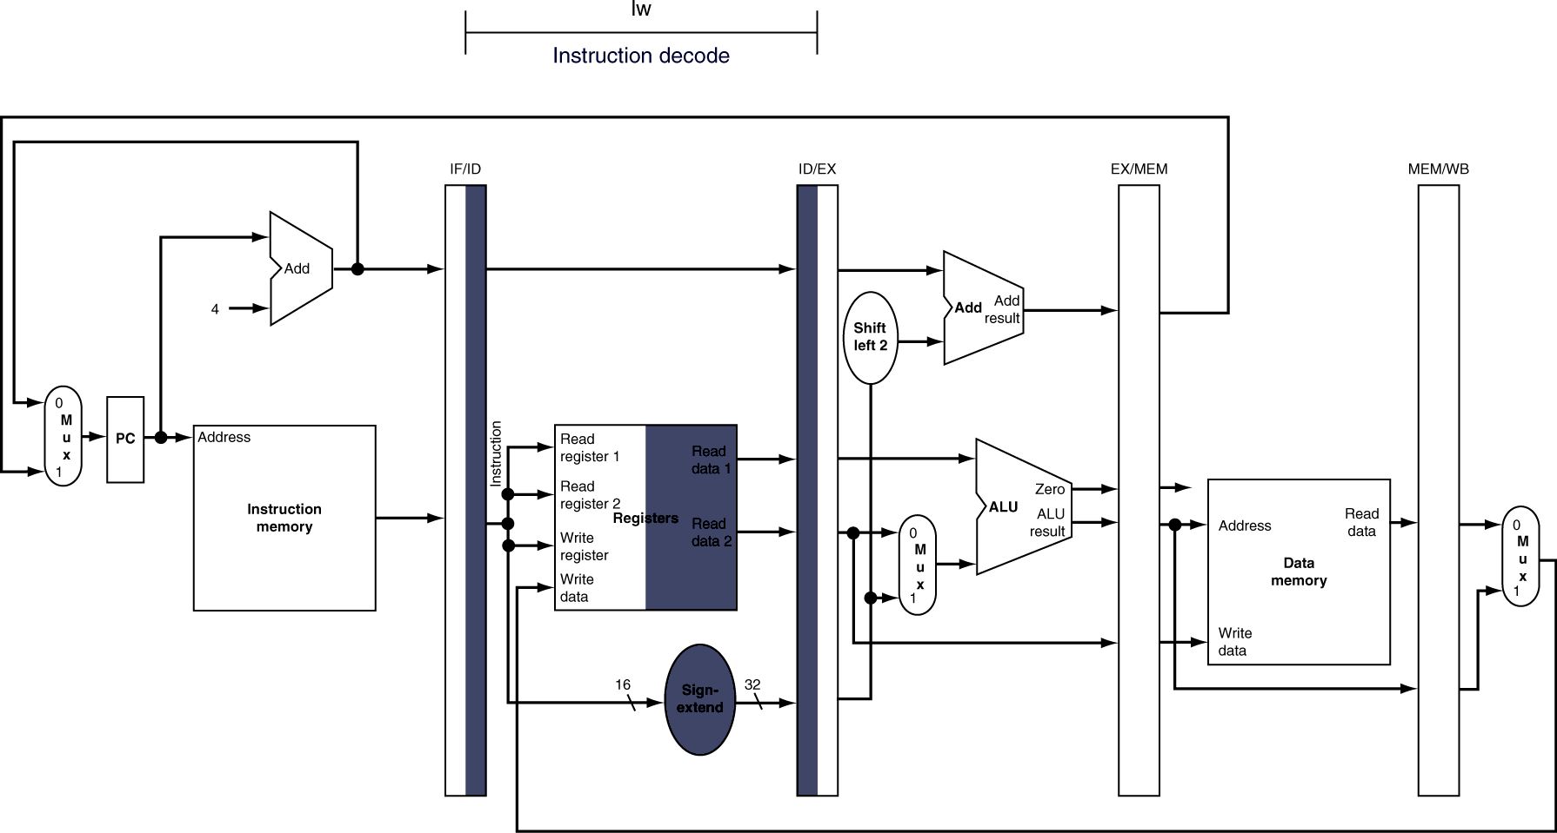
ID for Load, Store, …
Notes:
Morgan Kaufmann Publishers
Chapter 4 — The Processor

Slide 17
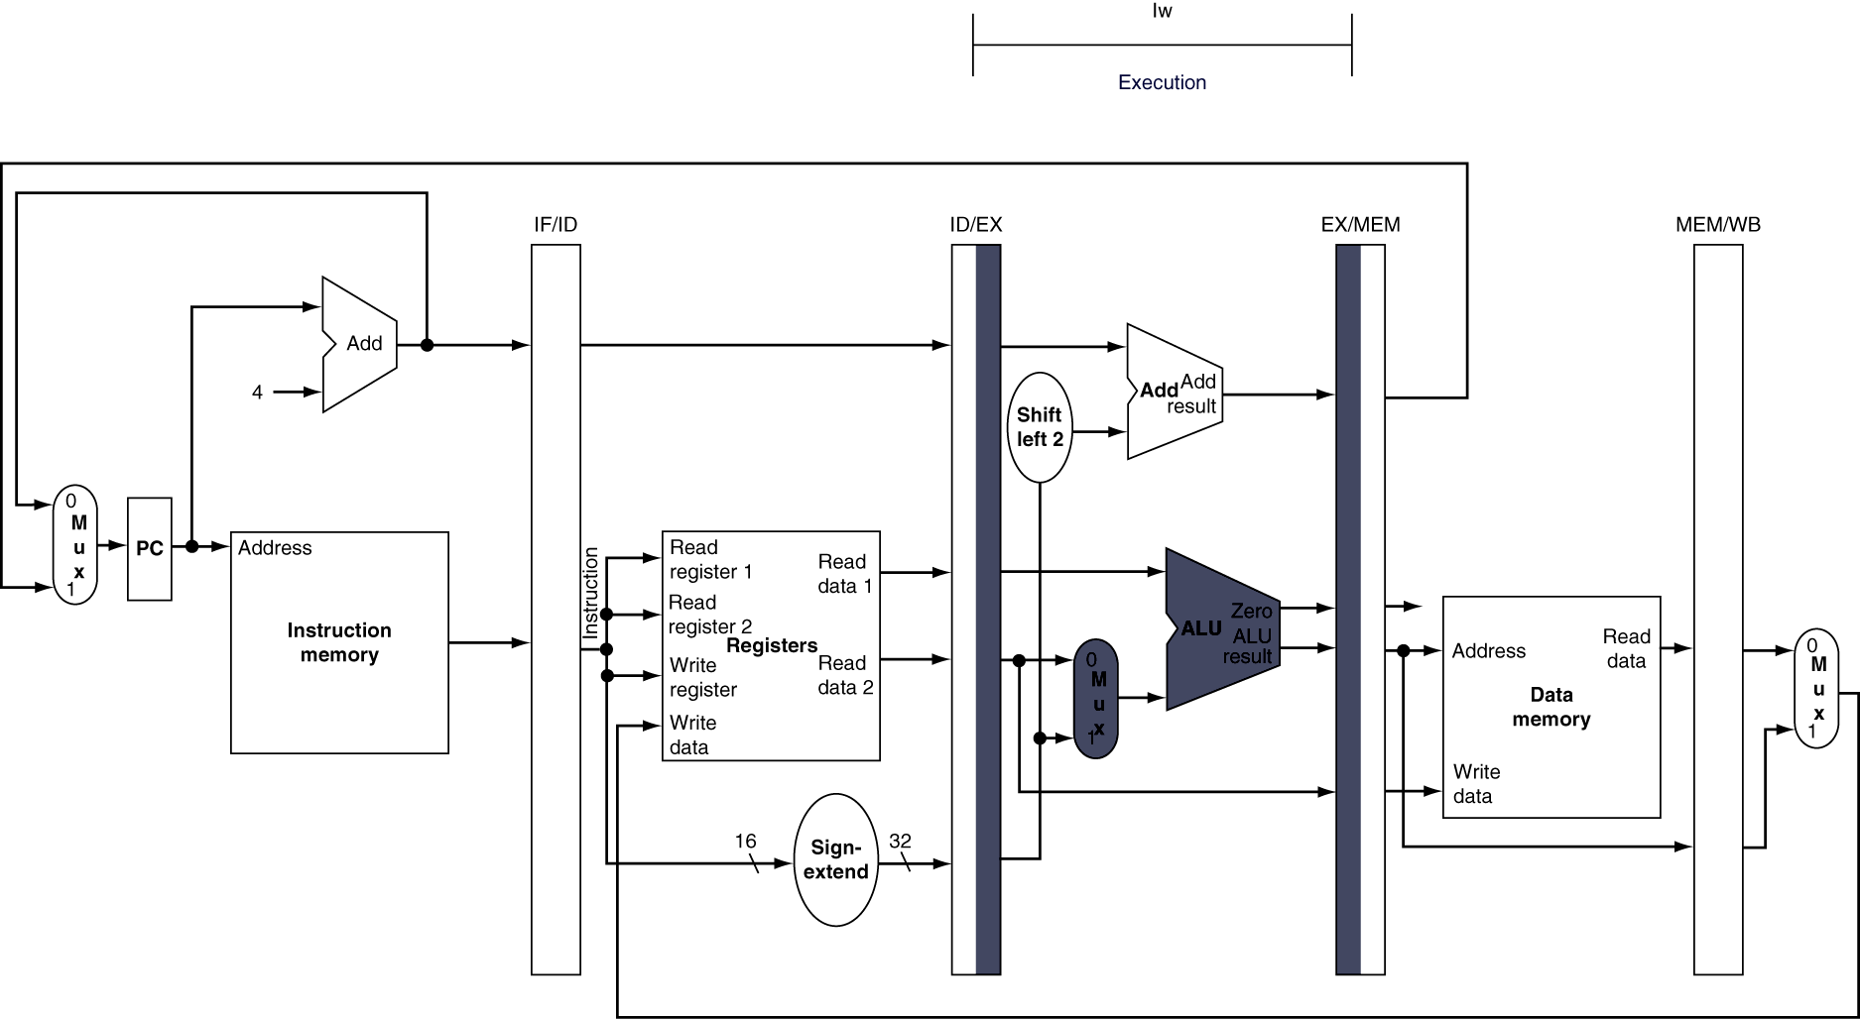
EX for Load
Notes:
Morgan Kaufmann Publishers
Chapter 4 — The Processor

Slide 18
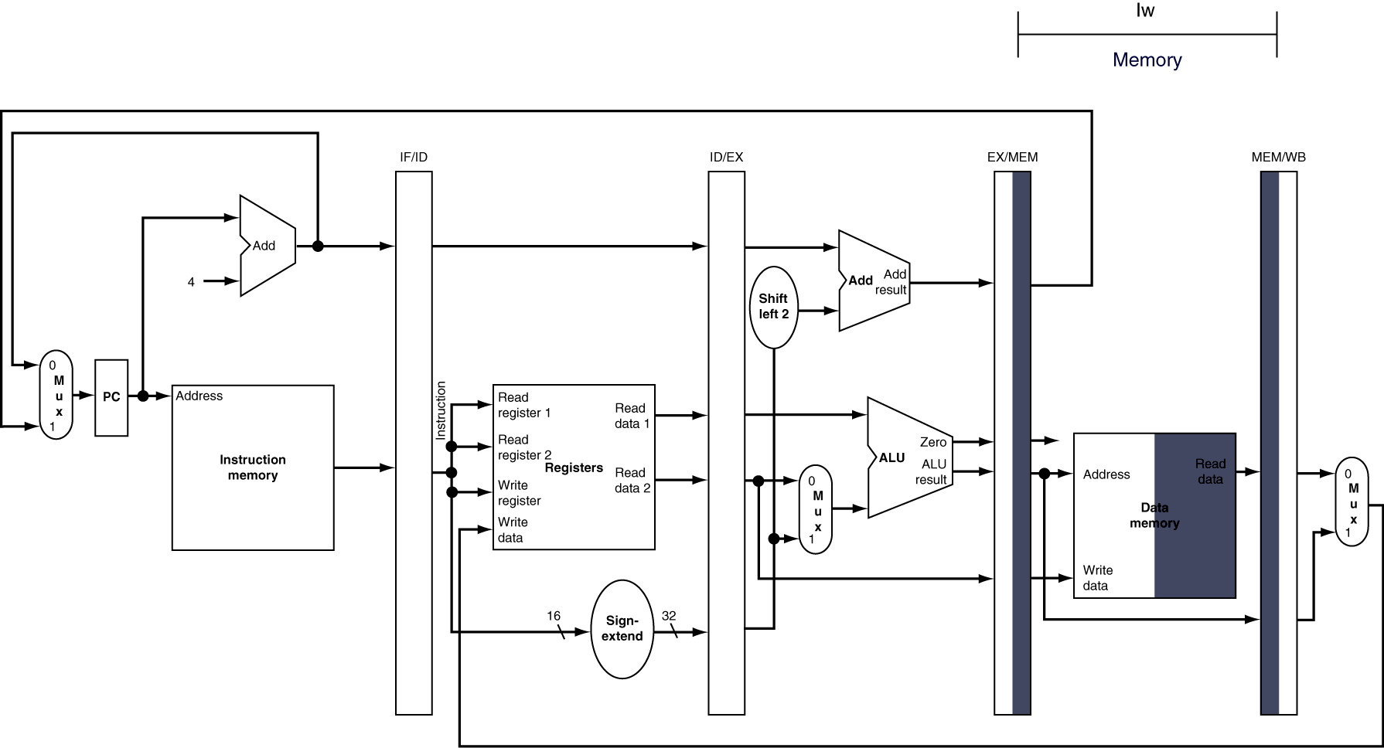
MEM for Load
Notes:
Morgan Kaufmann Publishers
Chapter 4 — The Processor

Slide 19
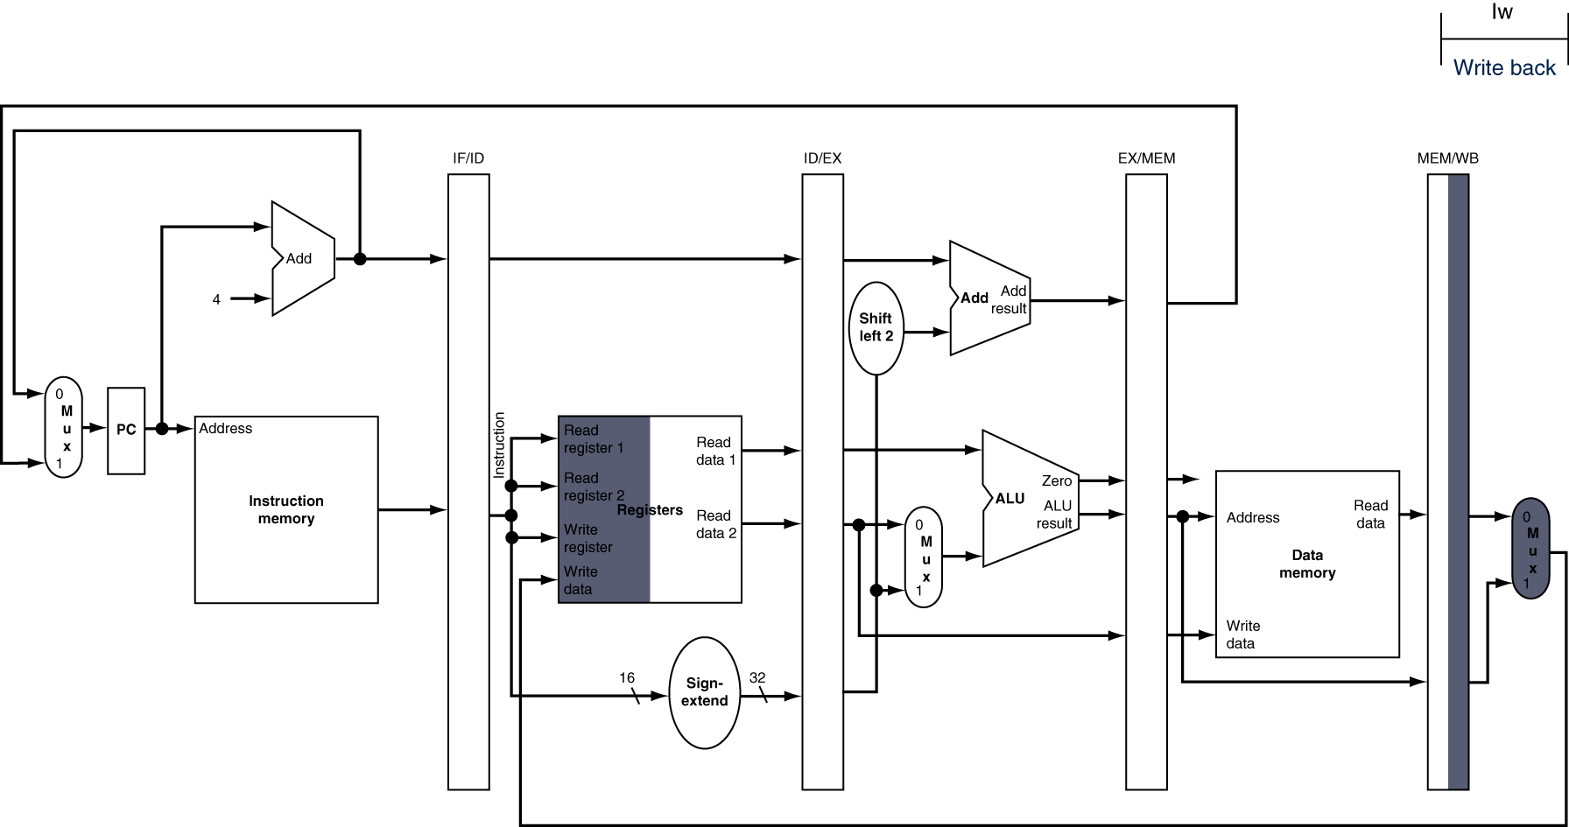
WB for Load
Wrong
register
number
Notes:
Morgan Kaufmann Publishers
Chapter 4 — The Processor

Slide 20
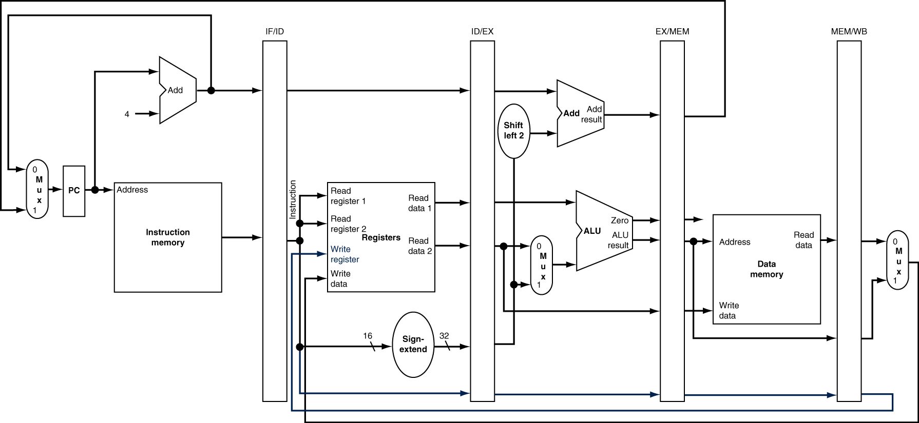
Corrected Datapath for Load
Notes:
Morgan Kaufmann Publishers
Chapter 4 — The Processor

Slide 21
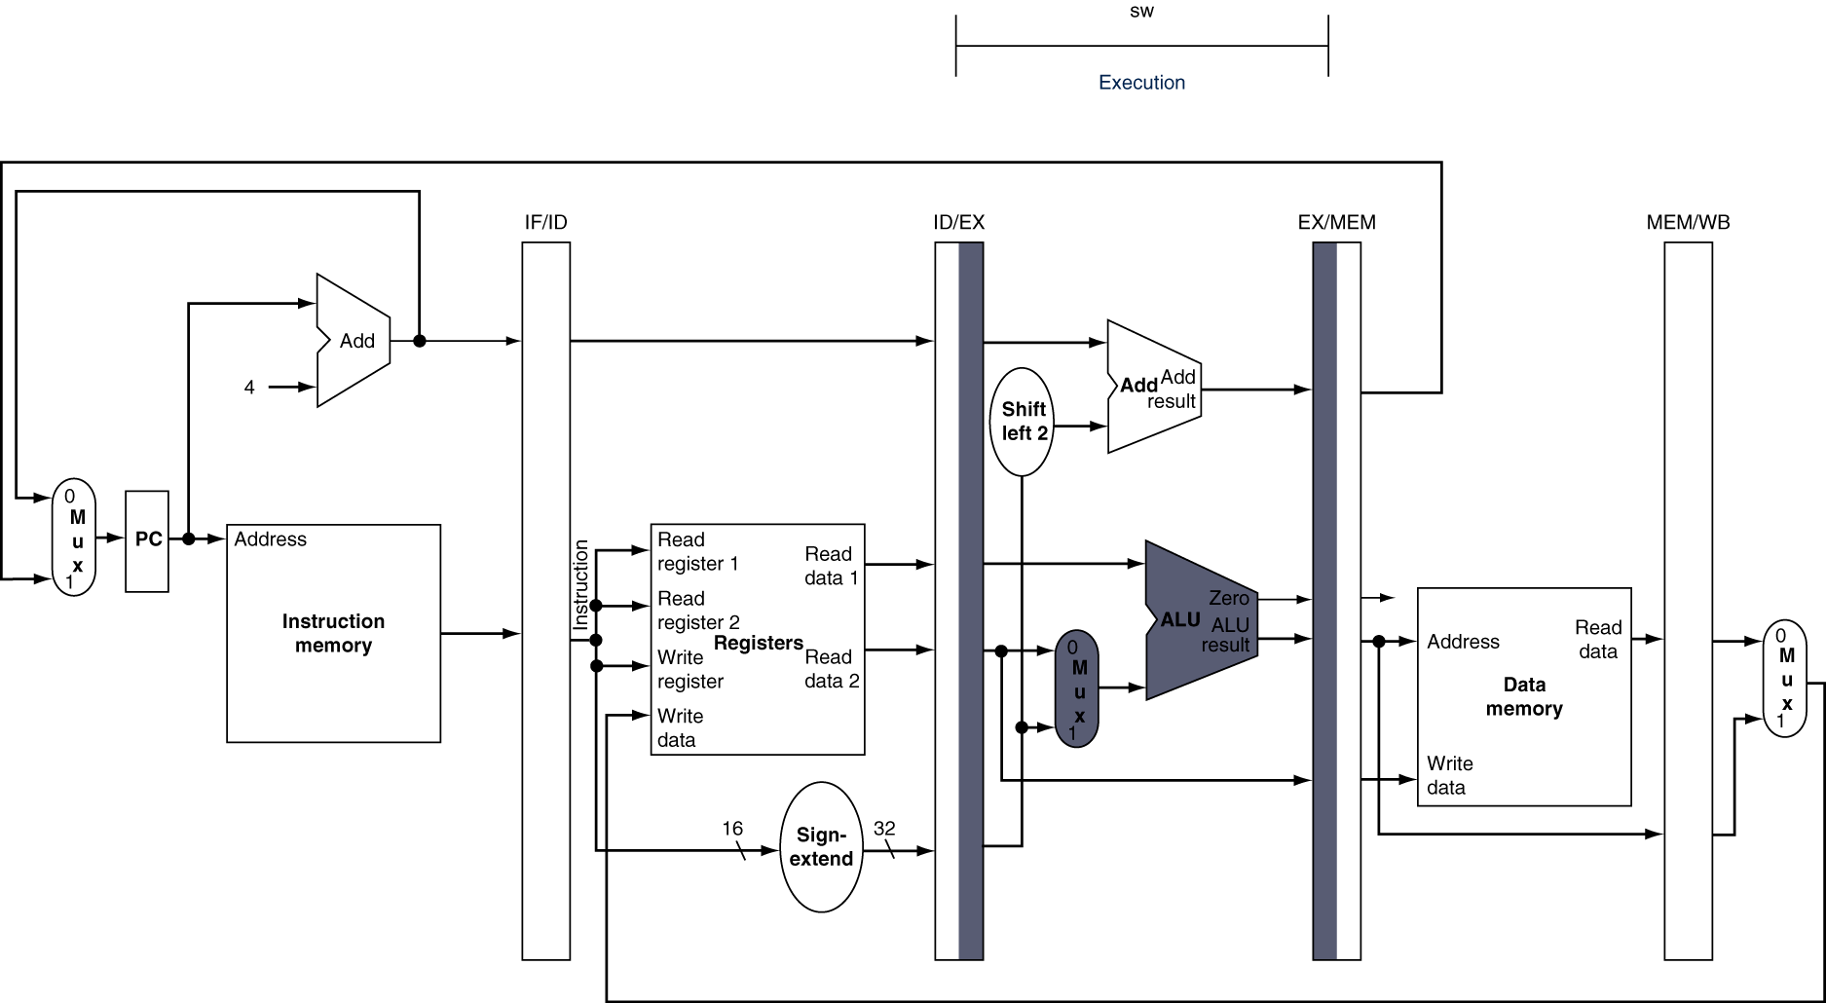
EX for Store
Second register value is loaded into the EX/MEM pipeline register
Notes:
Morgan Kaufmann Publishers
Chapter 4 — The Processor

Slide 22
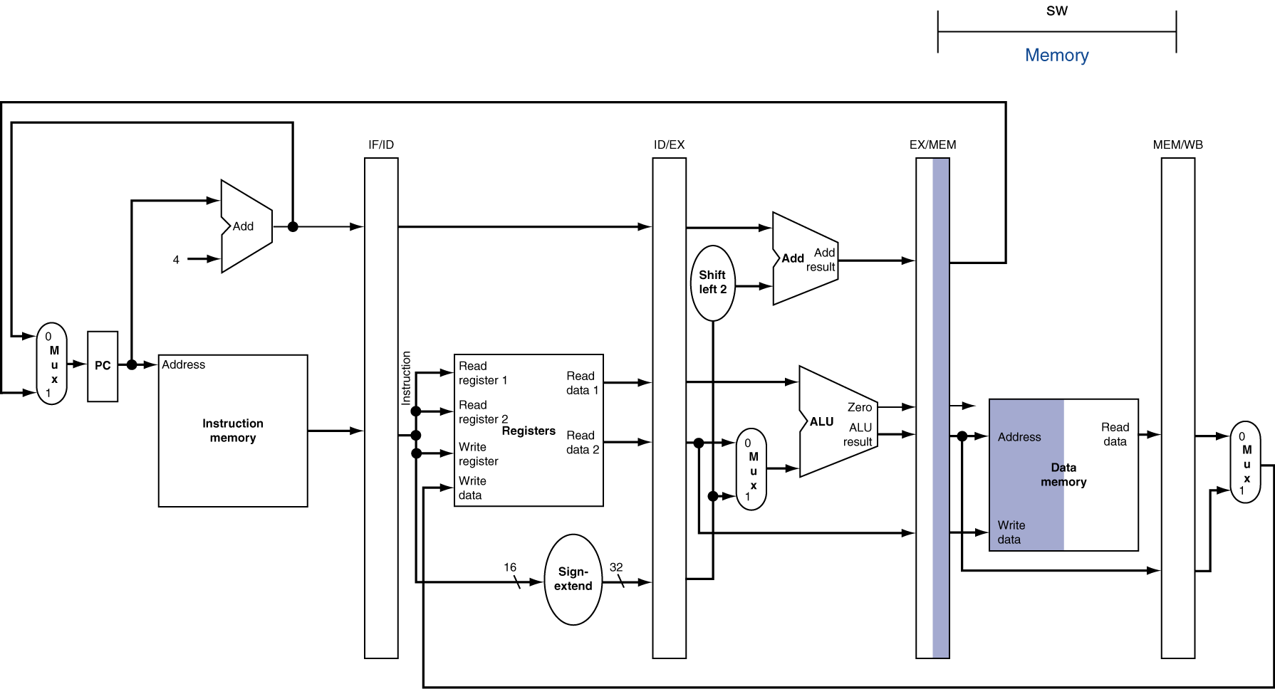
MEM for Store
Notes:
Morgan Kaufmann Publishers
Chapter 4 — The Processor

Slide 23
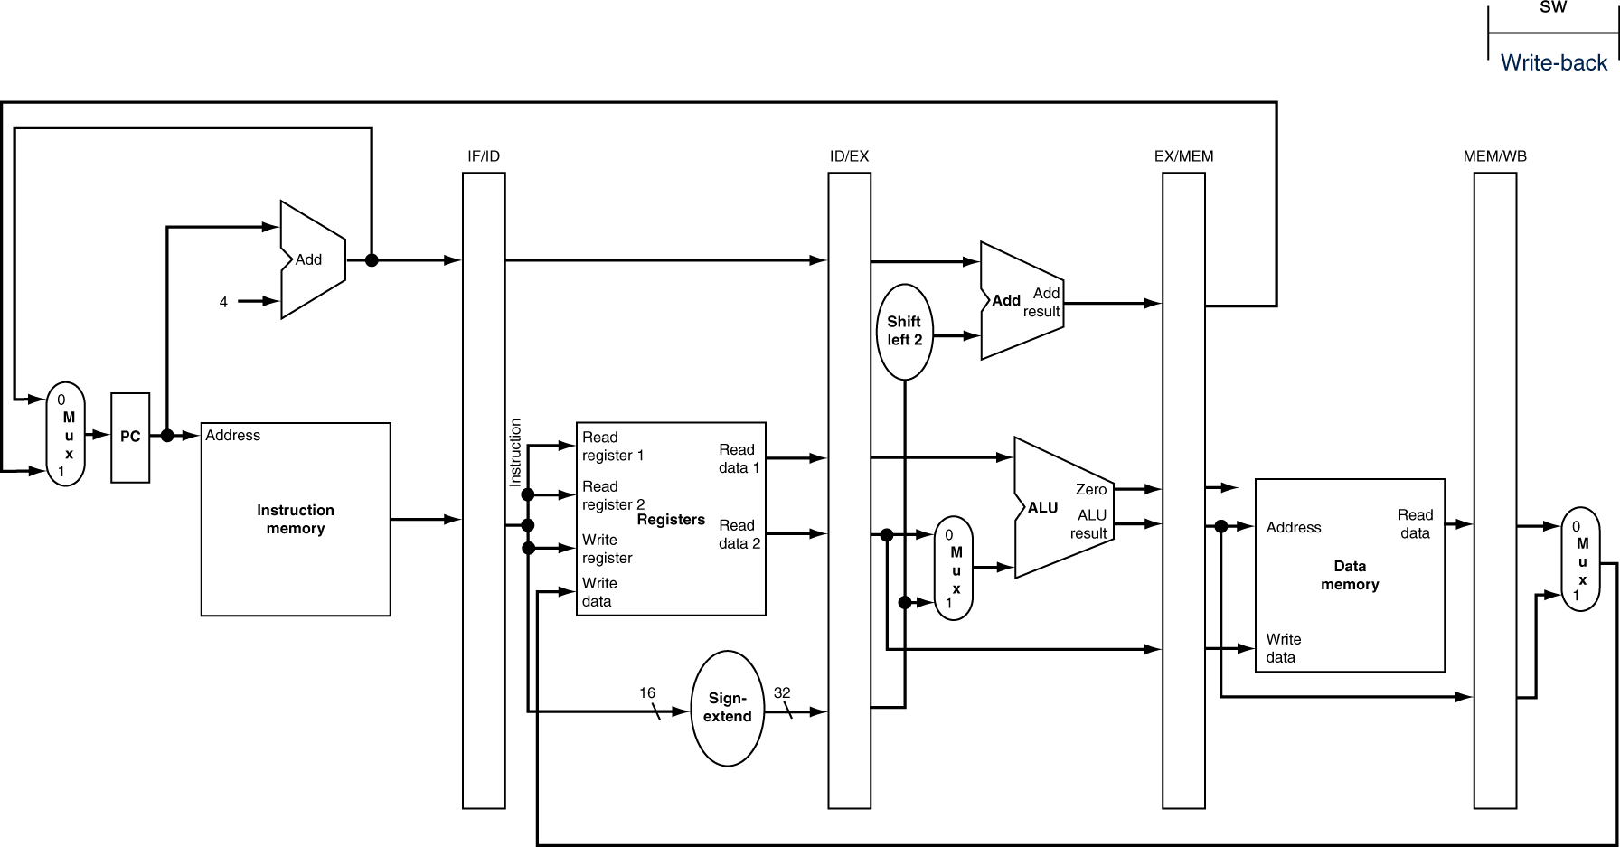
WB for Store
Notes:
Morgan Kaufmann Publishers
Chapter 4 — The Processor

Slide 24
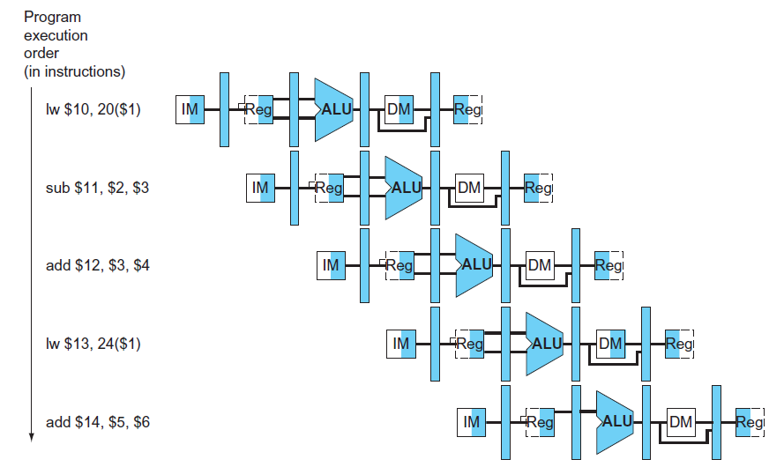
Multi-Cycle Pipeline Diagram
Form showing resource usage
Notes:
Morgan Kaufmann Publishers
Chapter 4 — The Processor

Slide 25
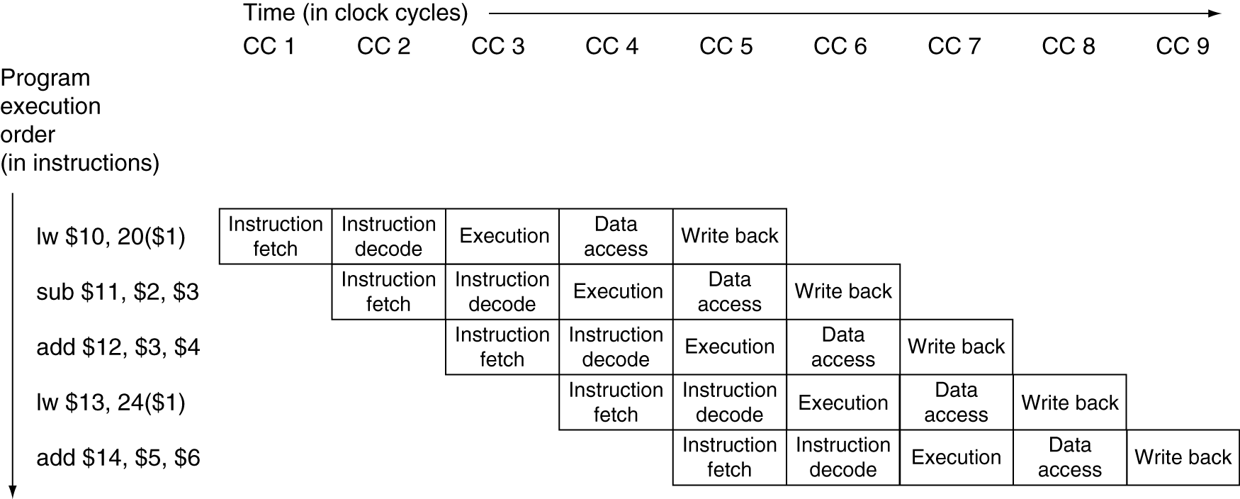
Multi-Cycle Pipeline Diagram
Traditional form
Notes:
Morgan Kaufmann Publishers
Chapter 4 — The Processor

Slide 26
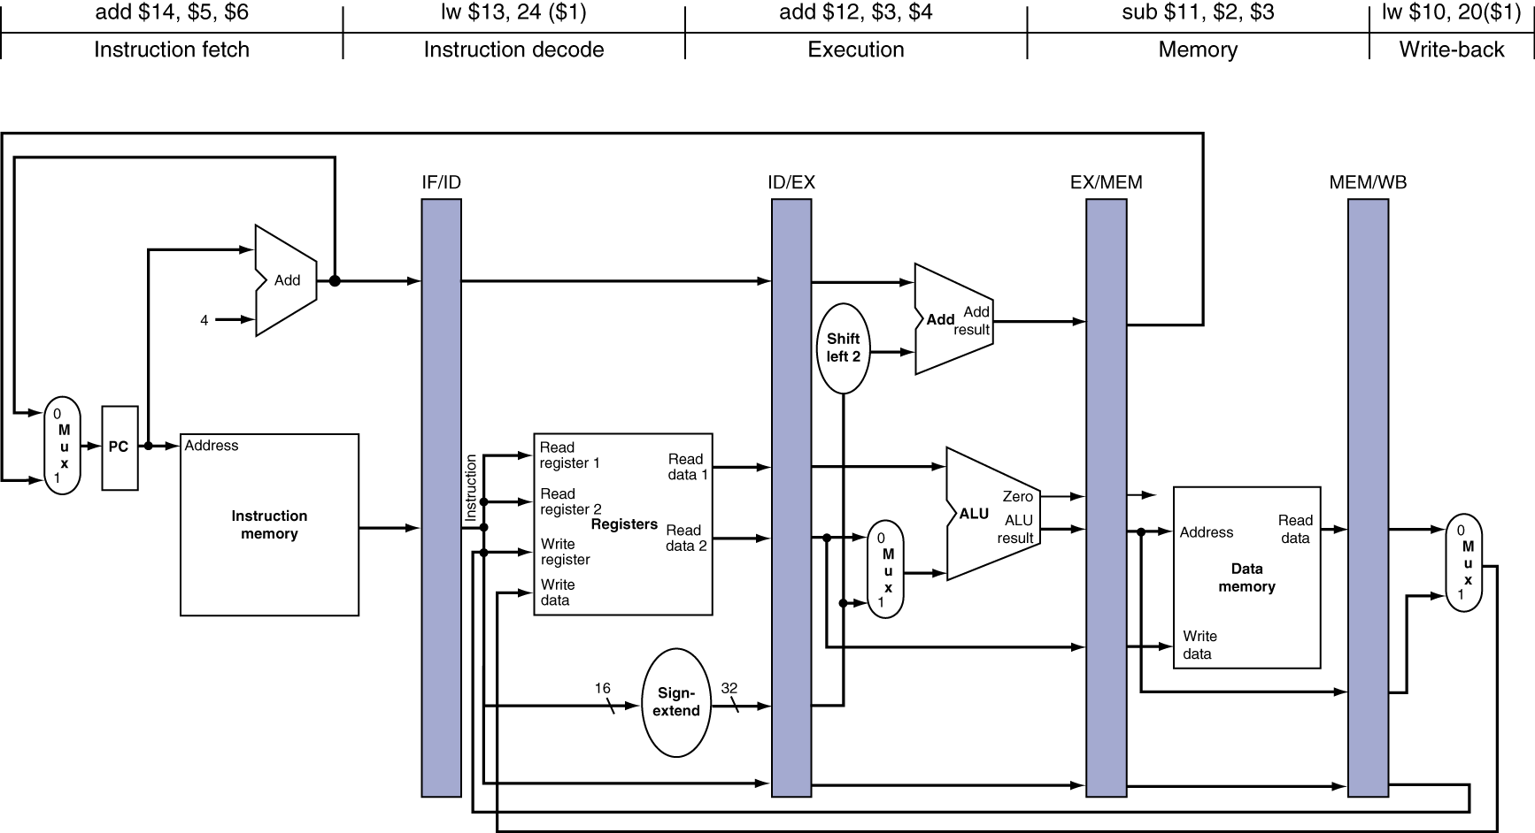
Single-Cycle Pipeline Diagram
State of pipeline in a given cycle
Notes:
Morgan Kaufmann Publishers
Chapter 4 — The Processor

Slide 27
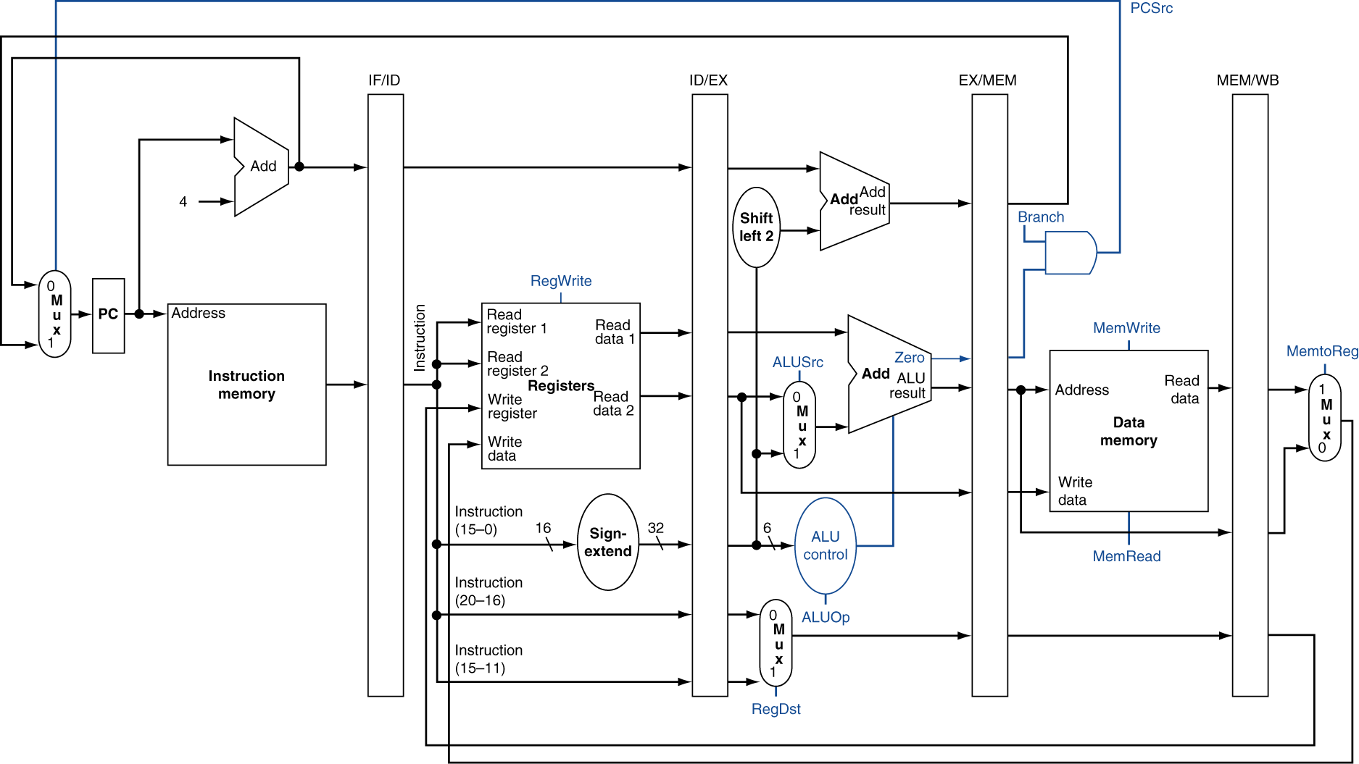
Pipelined Control
Notes:
Morgan Kaufmann Publishers
Chapter 4 — The Processor

Slide 28
Pipelined Control
Control signals derived from instruction
1. Instruction fetch:
  The control signals to read instruction memory and to write the PC are always asserted
2. Instruction decode/register file read:
  As in the previous stage, the same thing happens at every clock cycle, so there are no optional control lines to set.
3. Execution/address calculation:
  The signals to be set are RegDst, ALUOp, and ALUSrc
4. Memory access:
  The control lines set in this stage are Branch, MemRead, and MemWrite
5. Write-back:
  The two control lines are MemtoReg and Reg- Write
Notes:
Morgan Kaufmann Publishers
Chapter 4 — The Processor

Slide 29
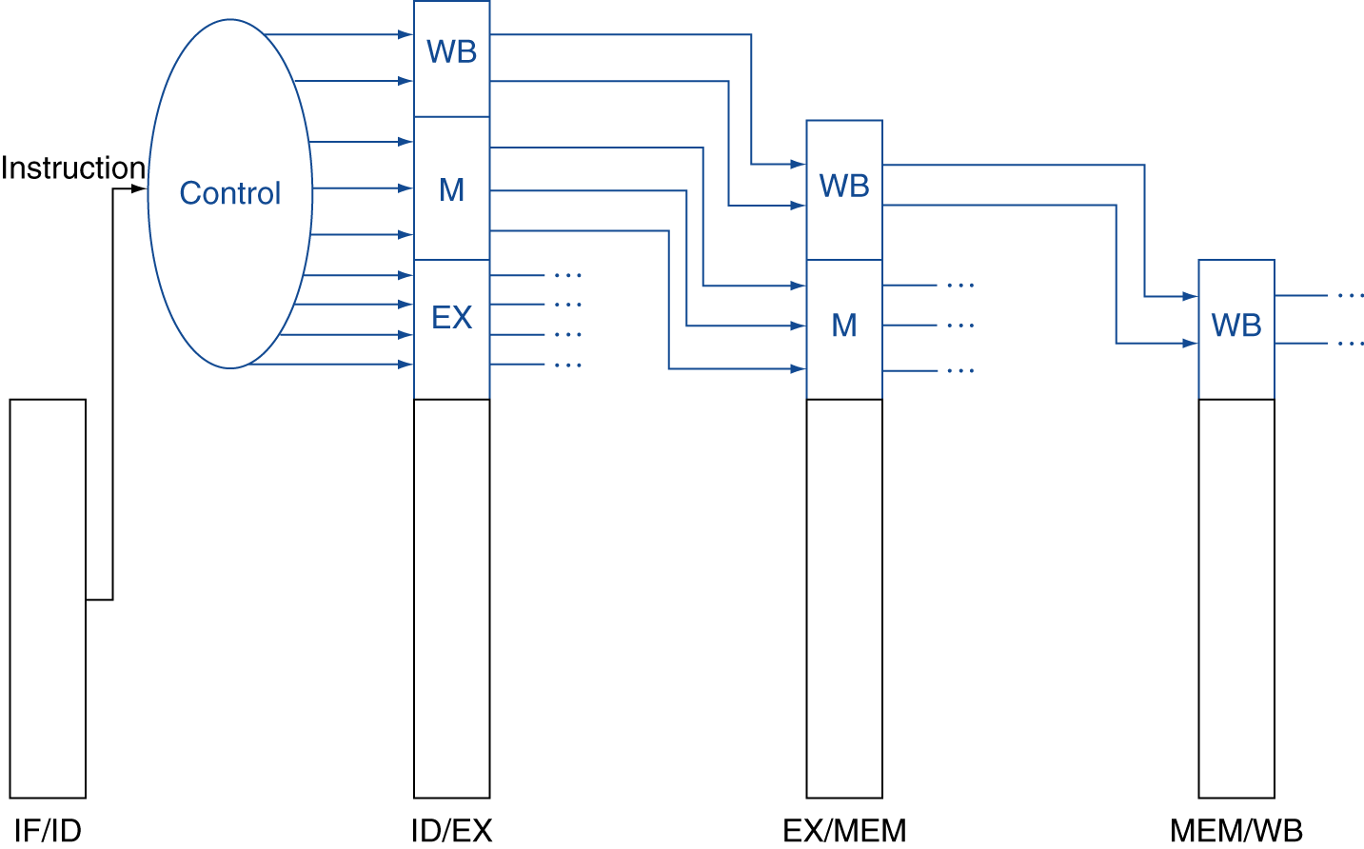
Pipelined Control
Control signals derived from instruction
  As in single-cycle implementation
Notes:
Morgan Kaufmann Publishers
Chapter 4 — The Processor

Slide 30
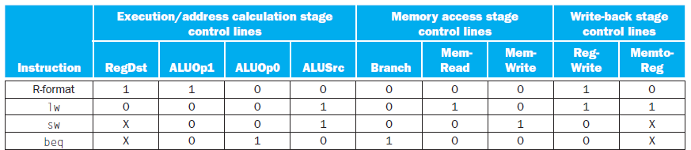
Pipelined Control
Control signals derived from instruction
Ins | ID/EX | EX/MEM | MEM/WB
lw $10, 20($1) | 0001 | 010 | 11
sub $11, $2, $3 | 1100 | 000 | 10
and $12, $4, $5 | 1100 | 000 | 10
or $13, $6, $7 | 1100 | 000 | 10
add $14, $8, $9 | 1100 | 000 | 10
Notes:
Morgan Kaufmann Publishers
Chapter 4 — The Processor

Slide 31
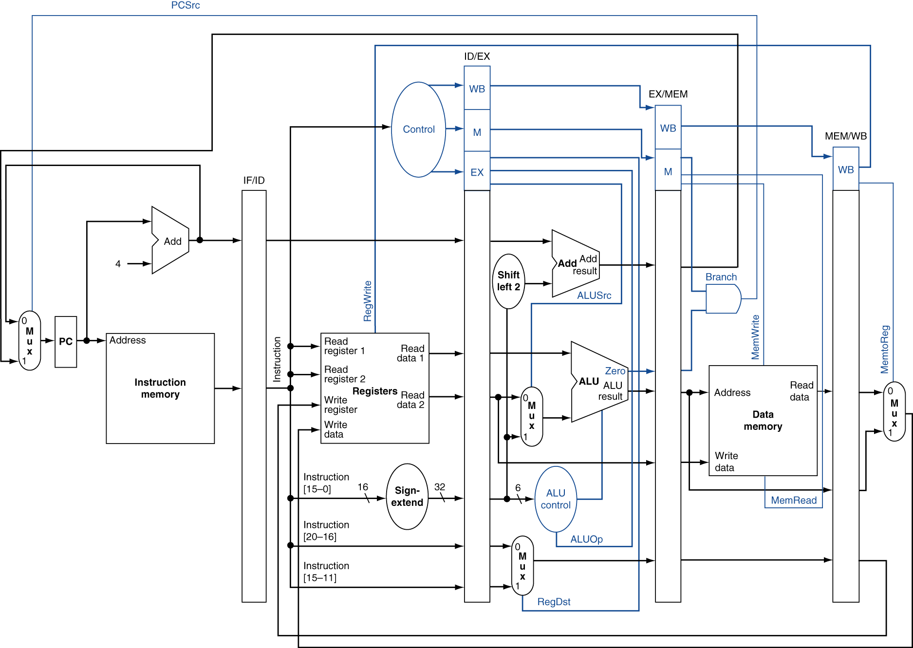
Pipelined Control
Notes:
Morgan Kaufmann Publishers
Chapter 4 — The Processor

Slide 32
Example
lw $10, 20($1)
sub $11, $2, $3
and $12, $4, $5
or $13, $6, $7
add $14, $8, $9
Ins | ID/EX | EX/MEM | MEM/WB
lw $10, 20($1) | 0001 | 010 | 11
sub $11, $2, $3 | 1100 | 000 | 10
and $12, $4, $5 | 1100 | 000 | 10
or $13, $6, $7 | 1100 | 000 | 10
add $14, $8, $9 | 1100 | 000 | 10

Slide 33
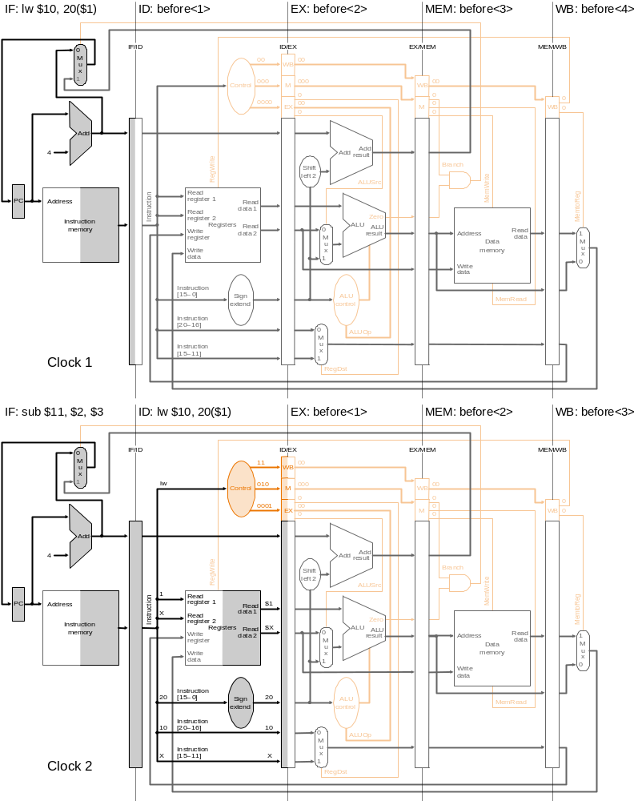
Cycle 1
Ins | ID/EX | EX/MEM | MEM/WB
lw $10, 20($1) | 0001 | 010 | 11
sub $11, $2, $3 | 1100 | 000 | 10
and $12, $4, $5 | 1100 | 000 | 10
or $13, $6, $7 | 1100 | 000 | 10
add $14, $8, $9 | 1100 | 000 | 10

Slide 34
Cycle 2
Ins | ID/EX | EX/MEM | MEM/WB
lw | 0001 | 010 | 11

Slide 35
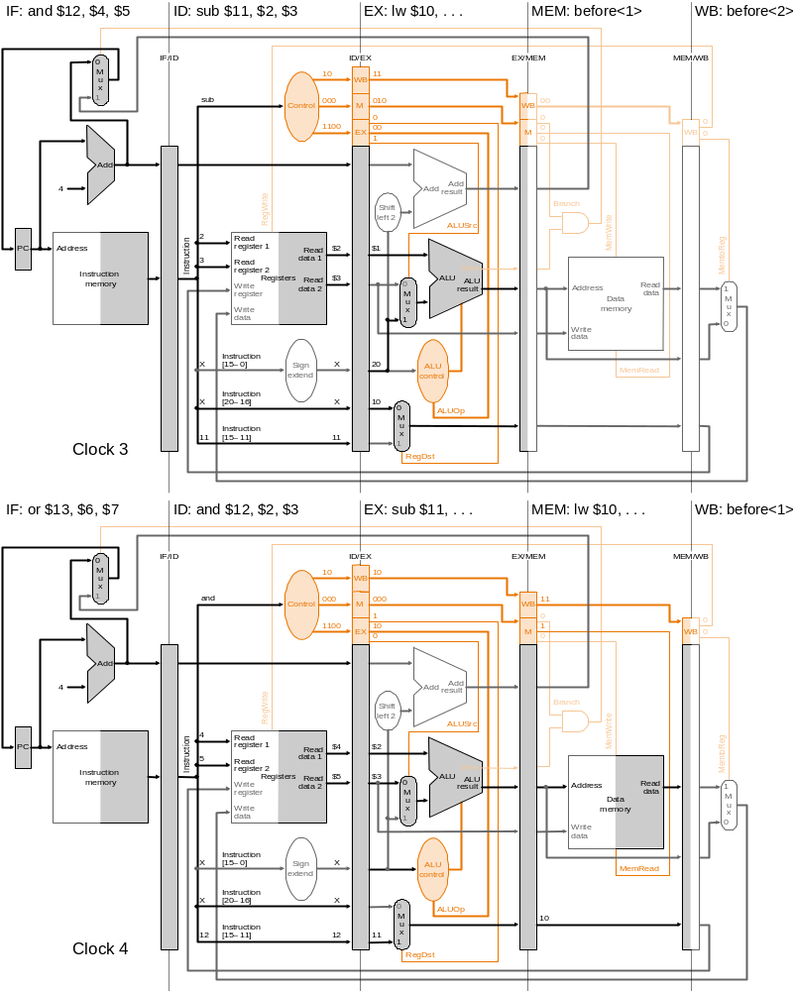
Cycle 3
Ins | ID/EX | EX/MEM | MEM/WB
lw | 0001 | 010 | 11
sub | 1100 | 000 | 10

Slide 36
Cycle 4

Slide 37
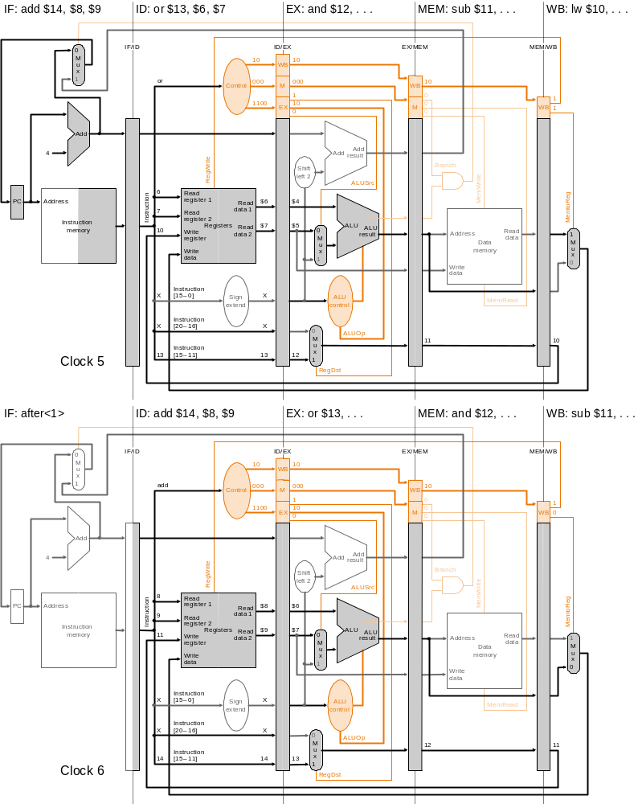
Cycle 5

Slide 38
Cycle 6

Slide 39
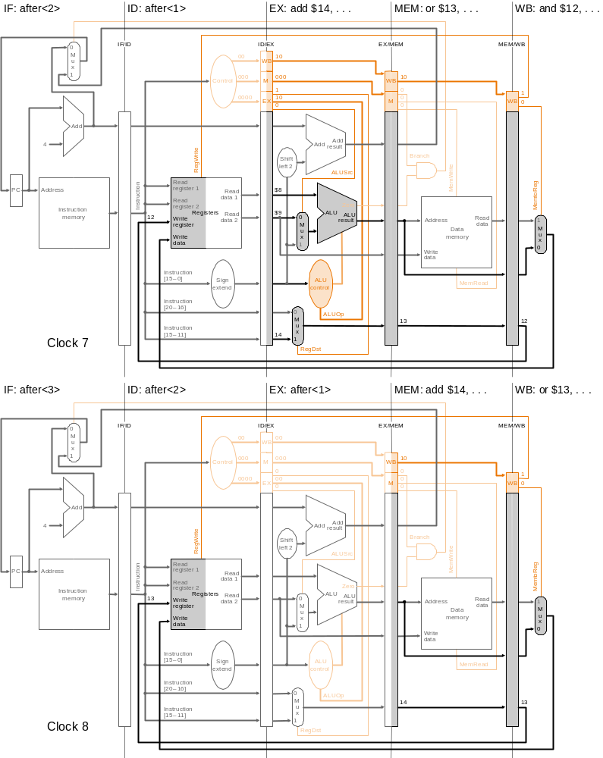
Cycle 7
Fig. 6.34

Slide 40
Cycle 8
Fig. 6.34

Slide 41
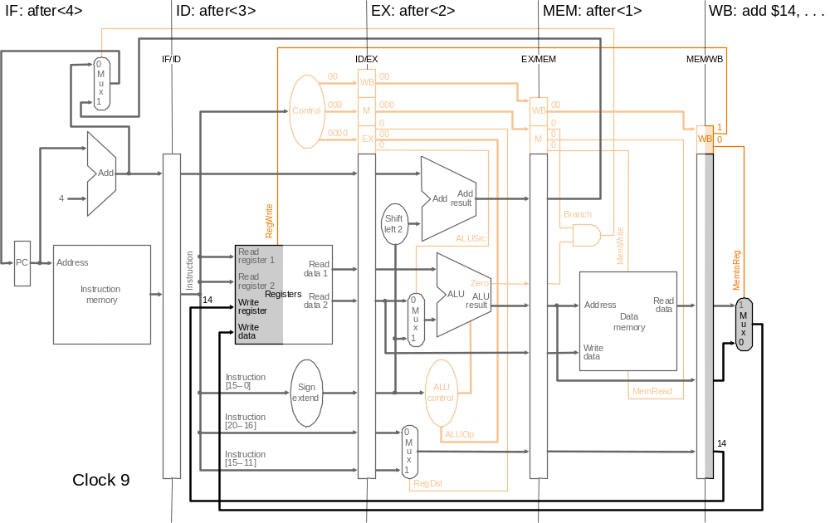
Cycle 9

